Slide 1
Lab Session 3
KNN Algorithm for Classification and Regression Analysis – Part 1
K. G. Lakshika Gamage

Slide 2
Why do we need KNN
KNN (K Nearest Neighbors) is one of the simplest supervised machine learning algorithm mostly used for classification.
It classifies a data point based on how its neighbors are classified.
KNN algorithm is based on feature similarity. Choosing the right value of K is a process called parameter tuning and is important for better accuracy.
KNN stores all available cases. Classified new cases based on similarity measures.
To choose a value of K
Sqrt(n) , where n is the total number of data point.
Odd value of K is selected to avoid confusion between two classes of data.
We can use KNN when
Data is labeled
Data is noise free
Data is small (because, KNN is a “lazy learner”)

Slide 3

How does KNN algorithm work
Two variables ------ height and weight
The data set ---- 9 data points ( K=sqrt(9) = 3 )
Based on BMI : the classification which are normal or underweight
Do not know how to calculate the BMI value???
New data point – height=170 cm and weight=57 kg
Cal. Euclidean distance to find the nearest neighbors
Euclidean Distance (d) = $\sqrt{{(x−a)}^{2}+{(y−b)}^{2}}$

Slide 4
Height | Weight | Class | Euclidean Distance
170 cm | 60 kg | Normal | d1= 1.4
…. | …. | Normal | d2 = 3.0
…. | …. | Normal | d3 = 2.0
…. | …. | Underweight | d4 =6.7
…. | …. | …… | d5 = 13
…. | …. | ……. | d6
…. | …. | ……. | d7
…. | …. | …. | d8
…. | …. | …. | d9

Slide 5
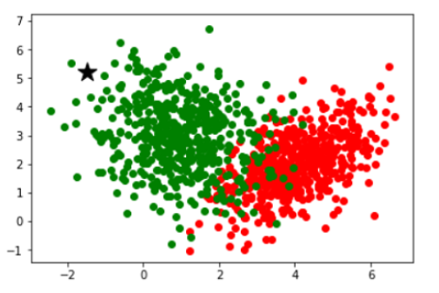

Slide 6
Implementation KNN Algorithm for Classification Problem
Ex: Predict whether a person will be diagnosed with diabetes or not
Diabetes Data Set: https://drive.google.com/drive/folders/1YylTjWxmkUVdurMSDjl84dstCKZL6wH8
Download this diabetes.csv file to your computer.

Slide 7
Steps:
Import pandas (data frame) and numpy (library which provides objects for multi dimensional arrays)
Import the sklearn modules for splitting data, preprocessing, feature scaling and metrices for testing.
Load the data set
Replace zeros.
Split the data set for training and testing
Feature Scaling
Define the model
Fit the model
Evaluate the model

Slide 8
Please refer the recording for implementation of the given example
Please try the coding for given data set
Next recording ----- Hyper parameter tuning

